Slide 1
CSE470: Software Engineering
Class Diagram

Slide 2
What is a Class
A general template that we use to create specific instances or objects in the application domain
Represents a kind of person, place, or thing about which the system will need to capture and store information
Abstractions that specify the attributes and behaviors of a set of objects

Slide 3
What is an Object
Entities that encapsulate state(attributes) and behavior(methods)
Each object has an identity
It can be referred individually
It is distinguishable from other objects (separate memory location for each object)

Slide 4
Potential Classes
External entities (e.g., other systems, devices, people) that produce or consume information to be used by a computer-based system.
Things (e.g., reports, displays, letters, signals) that are part of the information domain for the problem.
Occurrences or events (e.g., a property transfer or the completion of a series of robot movements) that occur within the context of system operation.
Roles (e.g., manager, engineer, salesperson) played by people who interact with the system.
Organizational units (e.g., division, group, team) that are relevant to an application.
Places (e.g., manufacturing floor or loading dock) that establish the context of the problem and the overall function of the system.
Structures (e.g., sensors, four-wheeled vehicles, or computers) that define a class of objects or related classes of objects.

Slide 5
Types of Classes during Analysis
Concrete
Class from application domain
Example: Customer class and Employee class
Abstract
Useful abstractions
Example: Person class

Slide 6
Classes
A class is a description of a set of
objects that share the same attributes,
operations, relationships, and semantics.
Graphically, a class is rendered as a
rectangle, usually including its name,
attributes, and operations in separate,
designated compartments.
ClassName
Attributes
Operations

Slide 7
Class Name
The name of the class is the only required tag in the graphical representation of a class. It always appears in the top-most compartment.
ClassName
Attributes
Operations

Slide 8
Attributes in a Class
Properties of the class about which we want to capture information
Represents a piece of information that is relevant to the description of the class within the application domain
Only add attributes that are primitive or atomic types like Boolean, string, char, integer, float, double, date etc.
Derived attribute
Attributes that are calculated or derived from other attributes
Denoted by placing slash (/) before name

Slide 9
Class Attributes
Person
An attribute is a named property of a
class that describes the object being modeled.
In the class diagram, attributes appear in
the second compartment just below the
name-compartment.
name : String
address : Address
birthdate : Date
ssn : Id

Slide 10
Class Attributes
Person
Attributes are usually listed in the form:
attributeName : Type
A derived attribute is one that can be
computed from other attributes, but
doesn’t actually exist. For example,
a Person’s age can be computed from
his birth date.
A derived attribute is designated by a preceding ‘/’ as in:
/ age : Date
name : String
address : Address
birthdate : Date
/ age : Date
ssn : Id

Slide 11
Class Operations
Person
Represents the actions or functions that a class can perform
Describes the actions to which the instances of the class will be capable of responding
Can be classified as a constructor, query, or update operation
Operations describe the class behavior and appear in the third compartment.
name : String
address : Address
birthdate : Date
/ age : Date
ssn : Id
eat()
sleep()

Slide 12
Class Operations
You can specify an operation by stating its signature: listing the name, type, and default value of all parameters, and, in the case of functions, a return type.
PhoneBook
newEntry (n : Name, a : Address, p : PhoneNumber, d : Description)
getPhone ( n : Name, a : Address) : PhoneNumber

Slide 13
Drawing Classes
When drawing a class, you need not show attributes and operation in every diagram.
Person
Person
Person
name : String
birthdate : Date
ssn : Id
Person
eat()
sleep()
work()
play()
name
address
birthdate
Person
eat ()
play ()

Slide 14
Visibility of Attributes and Operations
You can specify an operation by stating its signature: listing the name, type, and default value of all parameters, and, in the case of functions, a return type.
Visibility | Symbol | Accessible to
Public | + | All objects within your system
Protected | # | Instances of the implementing class and its subclasses
Private | - | Instances of the implementing class
Package | ~ | Instances within the same package

Slide 15
Visibility of Attributes and Operations
Person
+ name : String
# address : Address
# birthdate : Date
/ age : Date
- ssn : Id
+ eat ()
+ sleep ()

Slide 16
Relationships among Classes
Represents a connection between multiple classes or a class and itself
2 basic categories:
Association relationships
Aggregation
Composition
Reflexive
Dependency
Generalization relationships

Slide 17
Association Relationship
If two classes in a model need to communicate with each other, there must be link between them. An association denotes that link.
Name of relationship type shown by:
drawing line between classes
labeling with the name of the relationship
indicating with a small solid triangle beside the name of the relationship the direction of the association
Patient
Provides
Medical History

Slide 18
Aggregation Relationship
Specialized form of association in which a whole is related to its part(s)
Represented by a-part-of relationship
Specifies a whole-part relationship between an aggregate (a whole) and a constituent part, where the part can exist independently from the aggregate.
Denoted by a hollow diamond on the association
Car
Engine

Slide 19
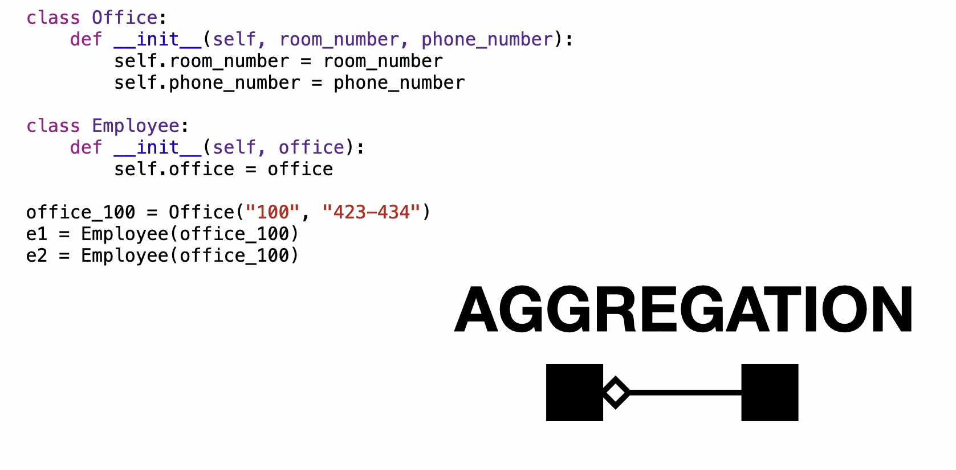
Aggregation Relationship

Slide 20
Composition Relationship
A composition indicates a strong ownership and coincident lifetime of parts by the whole.
Represented by a "is entirely made of" relationship
stronger version of aggregation
the parts live and die with the whole
symbolized by a black diamond
Window
Scrollbar
Titlebar
Menu

Slide 21
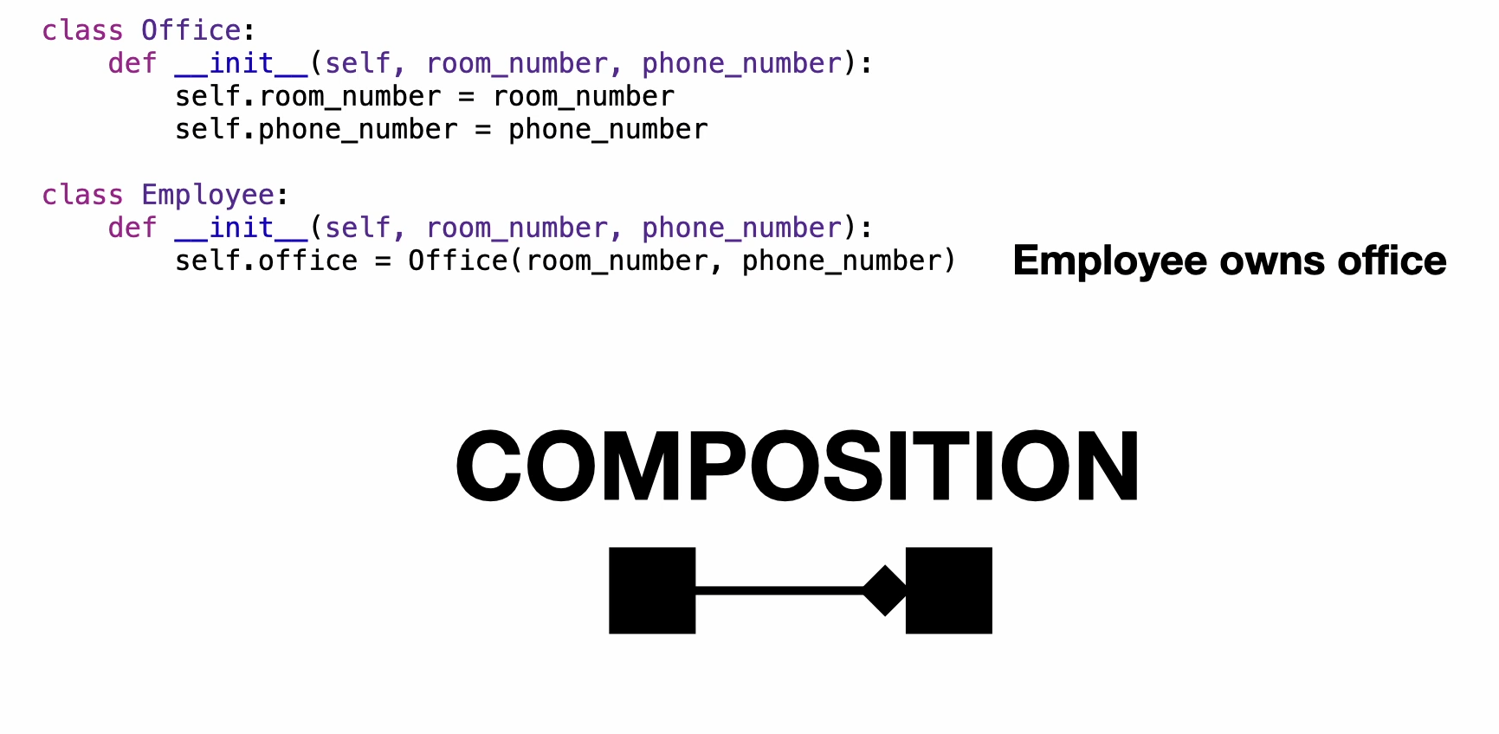
Composition Relationship

Slide 22
1. Association (The "Interacts With" Relationship)
Think of this as a casual relationship. Two independent things need to talk to each other to get something done, but neither "owns" the other. They both have their own separate lives.
Campus Example: A Student and a Professor. A student asks the professor a question during office hours. They interact, but they are completely independent people.
Video Game Example: A Trainer and a Shop Clerk. You walk up to the clerk to buy potions. You interact to complete a transaction, and then you both go your separate ways.
UML Rule: They just use a simple line to connect.
2. Aggregation (The "Has-A" Relationship, Independent)
Think of this as a container and its contents. One thing "owns" or contains another, but if the container is destroyed, the contents inside will perfectly survive on their own.
Campus Example: A Backpack and a Textbook. A backpack contains textbooks. But if the backpack rips and you throw it in the trash, the textbooks don't magically disappear. You just take them out and put them on your desk. They have an independent lifecycle.
Video Game Example: A Trainer and a Pokémon. A trainer "has a" Charizard in their party. But if the trainer decides to retire (or is deleted from the game's story), the Charizard isn't destroyed—it can be released back into the wild or traded to someone else.
UML Rule: Denoted by a hollow (empty) diamond.
3. Composition (The "Made-Of" Relationship, Coincident)
Think of this as strict anatomy. One thing is entirely made up of another, and the parts cannot exist without the whole. If the main object dies, the parts die with it.
Campus Example: A Textbook and a Page. A textbook is composed of pages. If you drop the textbook into a fire and it burns to ashes, the pages are destroyed right along with it. A "page 42" cannot logically exist floating in the void without the book it belongs to.
Video Game Example: A Pokémon and its Health Bar. A Charizard is composed of its specific stats and health bar. If that specific Charizard faints and is permanently deleted from your save file, its health bar is deleted from the game's memory too. The health bar cannot exist without the character it belongs to.
UML Rule: Symbolized by a black (filled) diamond.

Slide 23
Generalization Relationship
A generalization connects a subclass to its superclass. It denotes an
inheritance of attributes and behavior from the superclass to the subclass and indicates a specialization in the subclass
of the more general superclass.
Represented by a-kind-of relationship
Dog is a kind of Animal
Animal
Dog

Slide 24
Generalization Relationship
UML permits a class to inherit from multiple superclasses, although some programming languages (e.g., Java) do not permit multiple inheritance.
Student
Employee
Person
Employee
Customer
Teaching Assistant
Manager
Engineer

Slide 25
Generalization Relationship
Employee
hireDate: Date
- receivePay()
- performWork()
Manager
Engineer
department: String
bonus: Float
certifications: String
hireEmployee()
promoteEmployee()
analyze()
design()

Slide 26
Multiplicity
The multiplicity of a property is an indication of how many objects may fill the property. The most common multiplicities you will see are:
1 (An order must have exactly one customer.)
0..1 (A corporate customer may or may not have a single sales rep.)
* (A customer need not place an Order and there is no upper limit to the number of Orders a Customer may place—zero or more orders.)

Slide 27
Multiplicity
We can indicate the multiplicity of an association by adding multiplicity adornments to the line denoting the association.
The example indicates that a Student has one or more Instructors:
Student
Instructor
1..*
The example indicates that every Instructor has one or more Students:
Student
Instructor
1..*

Slide 28
Multiplicity
The following denotes the minimum number.. maximum number of instances
Exactly one 1
Zero or more 0..* or 0..m
One or more 1..* or 1..m
Zero or one 0..1
Specified range 2..4
Multiple, disjoint ranges 1..3, 5

Slide 29
Class Task
You've been assigned the development of a Library Management System. The library system is composed of multiple branches, each housing a collection of books and multimedia resources. The library has 3 types of items: Books, DVDs, and Journals. Each library item is identified by a distinct code, contains information about its acquisition date and a specific author or creator.
Library patrons can engage in activities such as borrowing items, returning them, and checking the availability of resources. In addition to the general library items, special features are implemented for different types of items. For instance, books can be reserved, DVDs have a return date, and Journals provide access to specific articles.
Library patrons are allowed to have multiple borrowed items, but each item is uniquely associated with one patron. The library is managed by a team of employees, each having a unique ID, name, hiring date, and expertise level indicating their experience in the library system.
The library staff is divided into two categories: Librarians and Assistants. Both roles have distinct attributes and methods tailored to their specific responsibilities within the library system. It is essential to ensure that the attributes and methods are appropriately configured for Librarians and Assistants to efficiently manage the library resources and provide quality service to patrons.
Create a class diagram based on the given scenario.

Slide 30
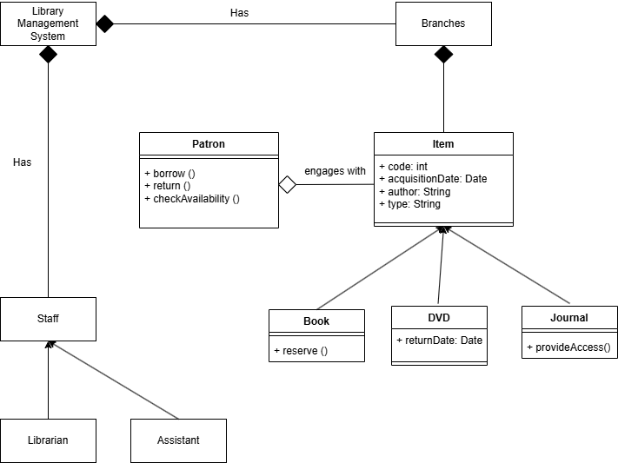
Class Task - Solve

